Slide 1
AI Introduction

Slide 2
AI
Data
AI General Tasks
Applications
Current Work
AI in Law

Slide 3
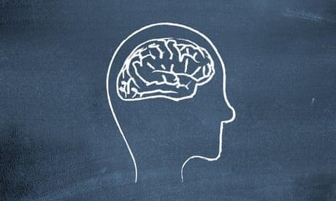
How Human mind thinks
Input Output

Slide 4
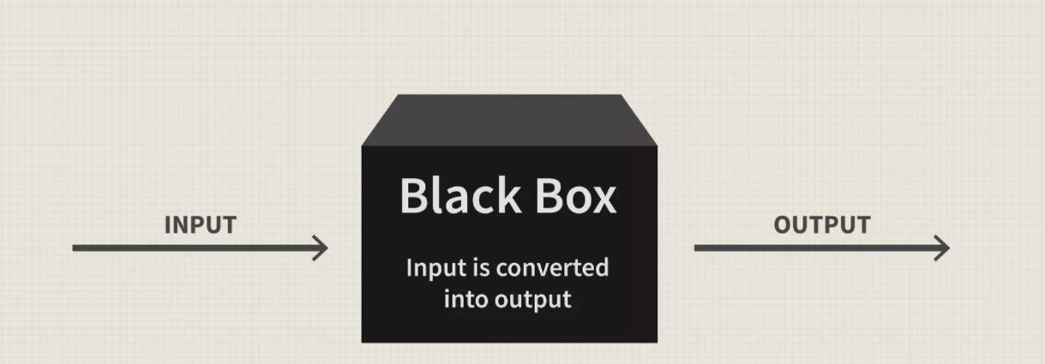
AI as blackbox

Slide 5



Let’s Go back to the school time
Teacher Student Books

Slide 6
Let’s Go back to the school time
Teacher Student Books
Provides the knowledge

Slide 7
Let’s Go back to the school time
Teacher Student Books
Learn from books Provides the knowledge Pass the exam based on learned Knowledge

Slide 8
Let’s Go back to the school time
Teacher Student Books
Evaluate our knowledge Learn from books Provides the knowledge Help in supervising Pass the exam based on learned Knowledge

Slide 9
Let’s Go back to the school time
Books
Question Answer
X Y

Slide 10
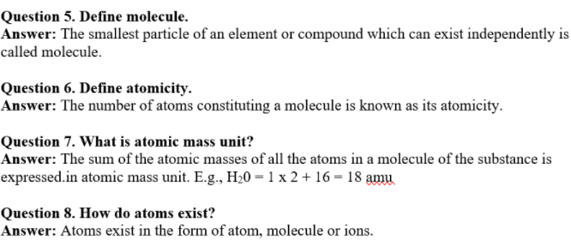
Let’s Go back to the school time
Books

Slide 11
Let’s Go back to the school time
Books
During Study
Question Answer
During Exam
Question ?

Slide 12
Let’s Go back to the school time
Books
Exams questions were not from books only but we still used to solve them
Based on old questions and knowledge we gained from books, lectures etc

Slide 13
Let’s Go back to the school time
Books
After exam we used to get marks based on our performance in exam paper

Slide 14

Let’s Go back to the school time
Teacher Student Books
Programmer

Slide 15
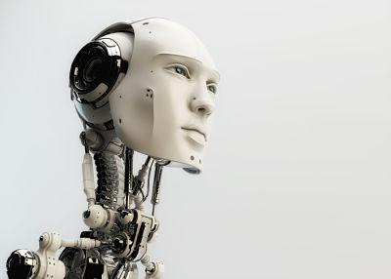
Let’s Go back to the school time
Teacher Student Books
Programmer
AI Model

Slide 16

Let’s Go back to the school time
AI Model
Teacher Student Books
Programmer
AI Model Digital Data

Slide 17
Let’s Go back to the school time
AI Data
Question Answer
Input Answer / Label

Slide 18
AI data format
X y
Question / Input Answer / Label

Slide 19


How Human maps and learns
We learn by mapping things/objects/feelings with a label
CAT
DOG
X Y

Slide 20
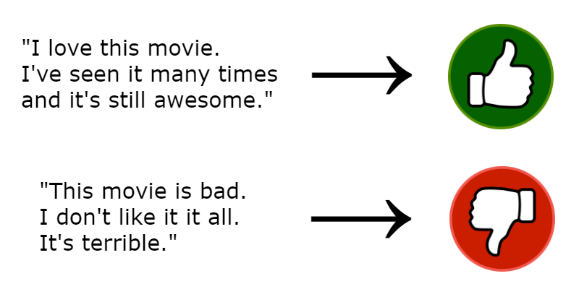
Sentiment analysis example
X Y

Slide 21
Single data point / Single question
X Y
Question / Input Answer / Label

Slide 22
Single data point / Single question
Model learn from this text We predict this
Question / Input Answer / Label

Slide 23
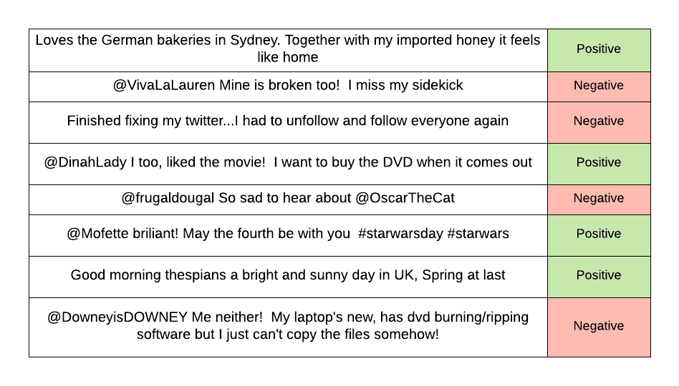
Sentiment analysis example
X Y

Slide 24
Let’s Go back to the school time
Books
During Study
Question Answer
During Exam
Question ?

Slide 25
Sentiment analysis example
During Training
Exam
X Y

Slide 26
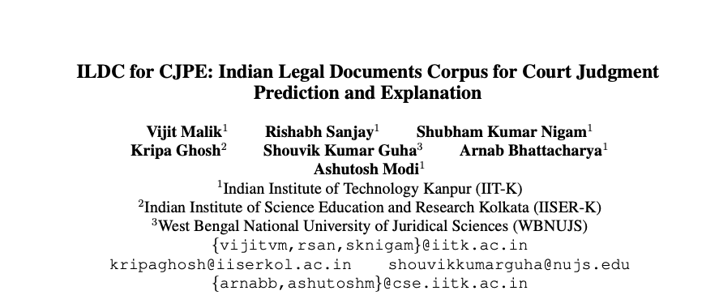
Paper discussion

Slide 27
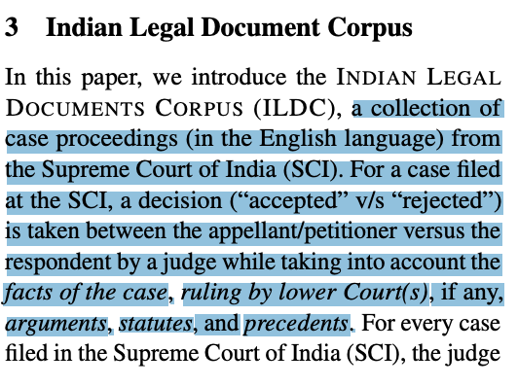
Paper discussion

Slide 28
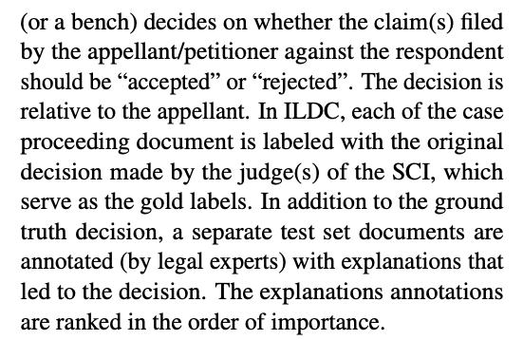
Paper discussion

Slide 29
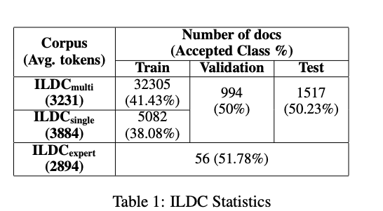
Paper discussion

Slide 30
Paper discussion

Slide 31
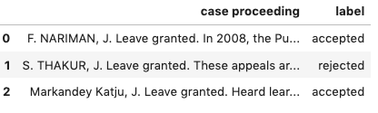
Paper discussion
X Y

Slide 32
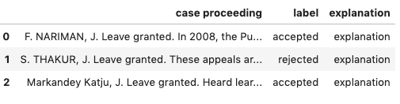
Paper discussion
X Y
Notes:
Summary
Large document
Section prediction
Relevant articles prediction
Previous paper is not using proceedings

Slide 33
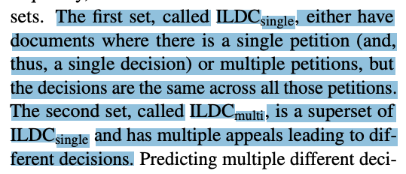
Paper discussion

Slide 34
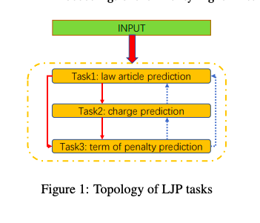
Law Articles Charges and Term of Penalty

Slide 35
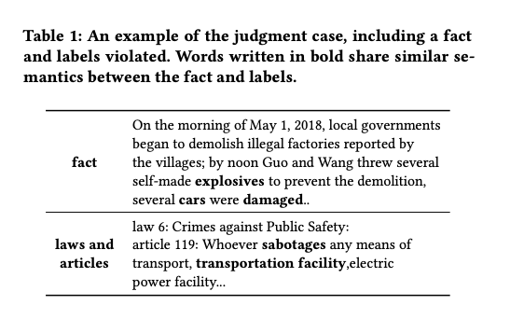
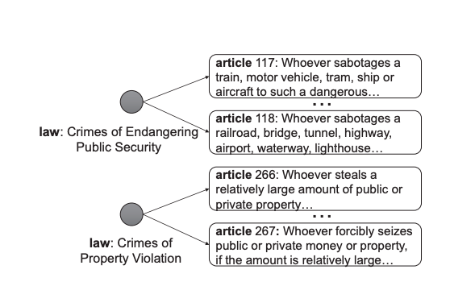
Paper discussion

